Slide 1
RAG Revisited
Grounding Answers with Evidence
DSC 360 Building AI-Powered Applications
Unit 8: From Prototype to Production

Slide 2
Discuss (1 min.)
In one sentence:
What is the point of RAG?
Follow-up: What evidence would you retrieve for this class of questions, and how would you know your answer is grounded?

Slide 3
Why RAG
Out of the box, LLMs are fluent, not factual
Knowledge changes beyond the model’s training
Context windows are limited
Grounding lets our systems cite, check, abstain

Slide 4
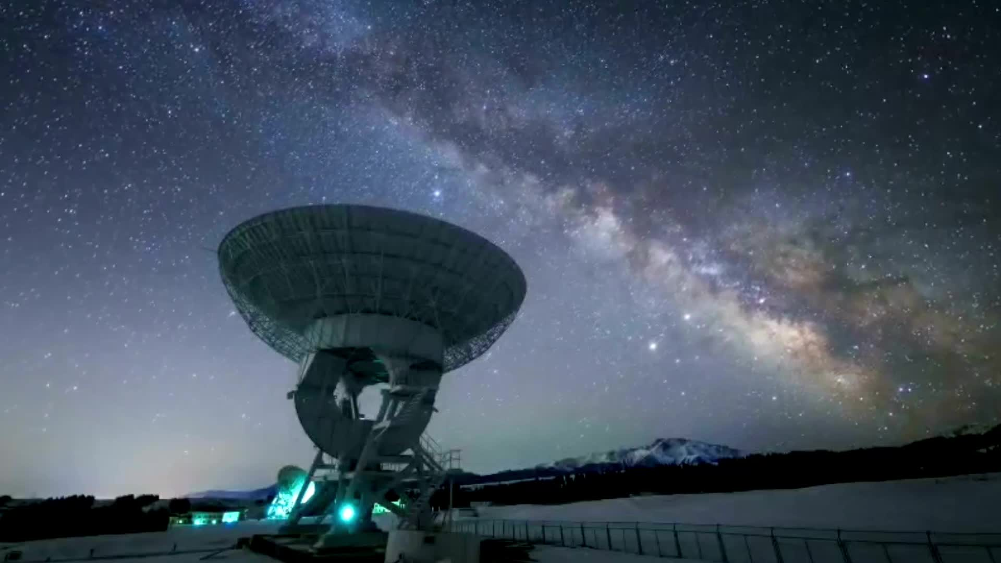
Retrieval: Our North Star

Slide 5
Discuss
What retrieval modes
are available to as we implement
AI-powered applications?

Slide 6
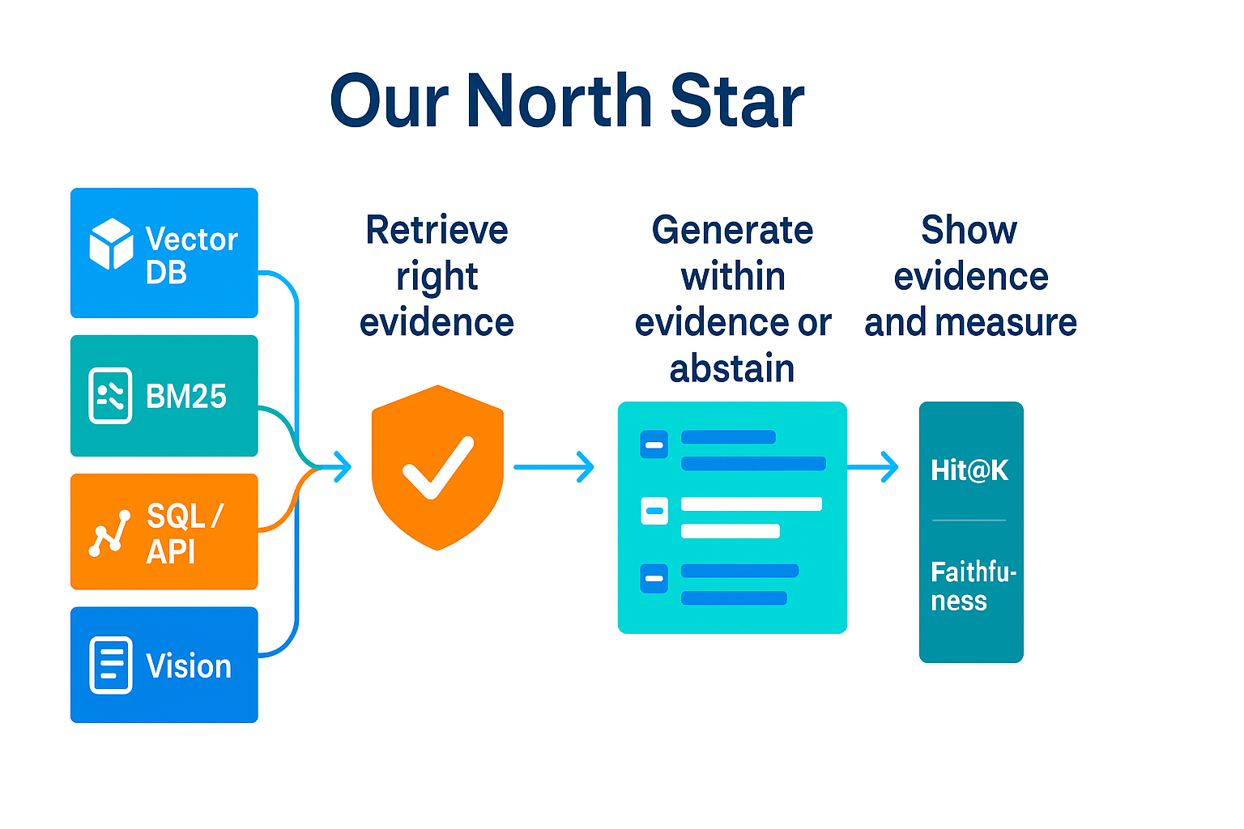

Slide 7
Retrieval Surface
Dense vectors Semantic KNN; first pass for meaning
BM25 keywords Exact IDs, names, error strings
Extraction-first Normalize messy text, then retrieve
SQL / APIs Facts, counts, joins; “show your work”
Vision → text Captions/OCR/tables, then same pipeline
Retrieval ≠ Vector Store

Slide 8

Control Surface

Slide 9
Guardrails
Cutoff → abstain/clarify
Evidence-only answers; show the evidence
Deterministic extract & SQL (temp=0); validate schema
Re-rank & order to avoid lost-in-the-middle

Slide 10
Operations
Timeouts, retries, rate limits
Circuit breaker for flaky tools
Logs + metrics (redact PII)
Read-only DB roles; allow-listed tools
Semantic cache; small-by-default (fallback bigger)

Slide 11
RAG within an Agent Loop
Perceive → Decide → Act → Reflect
Pick a tool: Retrieval • SQL/API • Vision→text
Generate from evidence only; abstain if weak
Self-check → re-rank, expand, or clarify
KB (agent memory): read facts; append facts/results with provenance
Notes:
Policy. Not sci-fi.
Examples: entities/summaries from docs, tool outputs (SQL rows, API JSON), user clarifications/preferences, lightweight semantic cache—each stamped with source, time, and confidence/TTL.

Slide 12
Worksheet: Modes

Slide 13
Reminder
Project Proposals due tonight (small part of your project grade)

